Slide 1
BOT-A-THON 2.0
Use case: Examination Cell
Team – IESians
from IES College of Technology Bhopal(M.P)
Team Lead : Abhishek Kushwaha
Amit Patel
Aman Rao

Slide 2
Problem Statement - 13
Develop a Bot which can help DCoE office to send a mail having original admit card as attachment to all student’s personal email id.
Admit card is in pdf format having two copies of each admit card i.e., original and duplicate copy.
Mail should be sent to all students with original copy of admit card and keep duplicate copy in DCoE separate folder named as branch, year and school.
Input: Excel file which is having all the data in given format and admit card in pdf format
Output: Mail to all registered students having admit card as attachment.

Slide 3
Observations in Input
In input PDF files, Each page is 1 admit card. First half of PDF files consists of Original Admit cards and 2nd half consists their respective duplicates in order.
Each Roll number is unique
Input Excel File consists of student details such as Name, Roll. No., Email id etc. to whom we have to mail Admit Card.

Slide 4
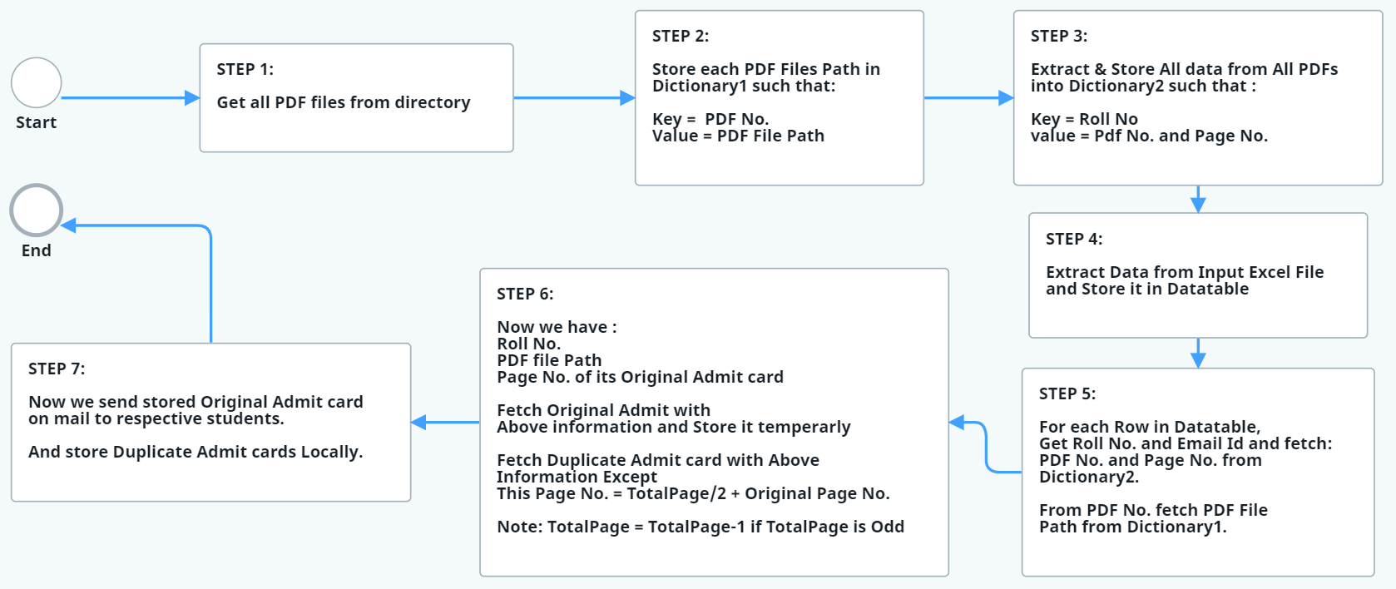
Workflow

Slide 5
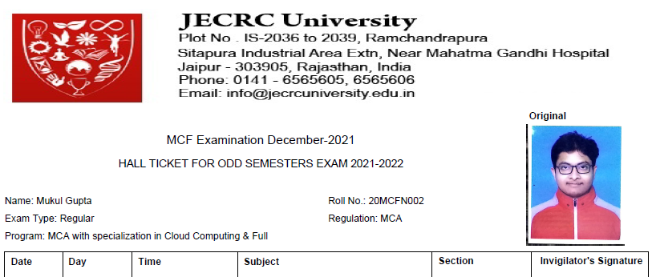
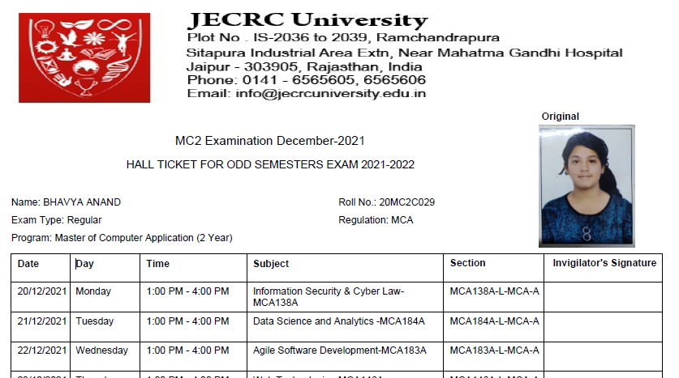
How does Data gets added to Dictionary ?
DICTIONARY2
KEYS
20MCFN002
20MC2C029
PDF No. | PAGE No.
4 | 2
1 | 1
VALUES
DICTIONARY1
PDF No.
4
1
PDF Path
“\input\file.pdf”
“\input\file2.pdf”

Slide 6
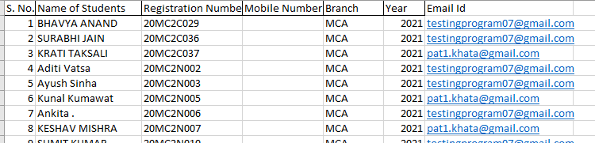
Input Excel file
Dictionary2( key => 20MC2C037 )
(PdfNo=> 4 , PageNo=> 12 )
Dictionary2( key => 20MC2N006 )
{output from Dictionary1 pdf to pdfPath}
(PdfPath=> “\input\file2.pdf”)
(PdfNo=> 4 , PageNo=> 12 )
{output from Dictionary1 pdf to pdfPath}
(PdfPath=> “\input\file.pdf”)
Extract PDF range
Activity ( PdfPath, Page No)
Mail admit card

Slide 7
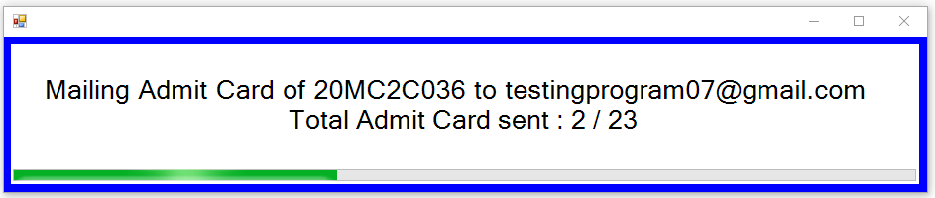
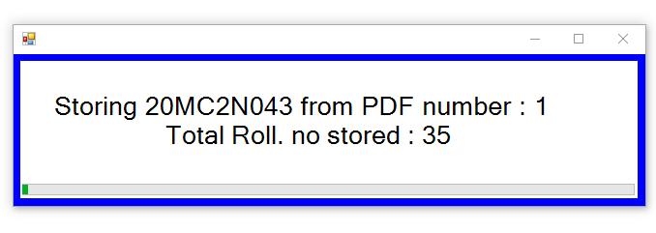
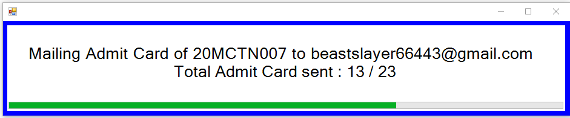
Features- Live Status
Live Status GUI which displays current activity information and Overall progress of process.

Slide 8
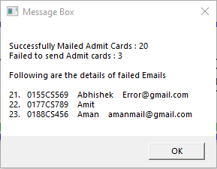
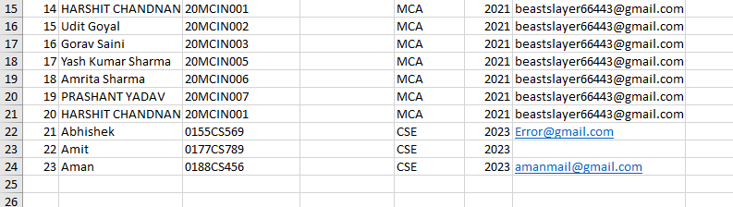
Features- Error Handling
Summary Message Box with success and errors and show after execution has finished. Also all summary with error is exported to \debug\summary.txt for future reference.
Input File

Slide 9
Features - Time Complexity
Takes : 2 secs for fetching all roll no. from 98 Admit Cards
Takes : Approx. 5sec at max to Mail 1 admit card.
For Comparison, for 5 branches with 180 students each, It would take
1hr 15mins to mail all 900 Admit cards.
All data storage has been achieved through Dictionaries and therefore fetching respective data at any point is constant time with roll number
5*180 = 900 students
Pre-processing = 2* (900/98) = 19 secs
Email sending = 5*900 = 4500 secs
Total = 4500+19 = 4519 secs = 1hr 15mins
Tested on laptop:
Ryzen 4600 CPU
16gb ddr4 RAM

Slide 10
Improvements
Validity check of Email using Regular Expressions.
Error Summary Report produced automatically in Excel format added.
Mail send fail due to Network timeout is accounted for in Error summary report Excel file.
“Error Types” column added in summary report Excel file with three different types namely –
Invalid Email
Roll no. Doesn’t Exits
Bad Network

Slide 11
Dependencies -
UiPath Studio
Microsoft Excel
Following UiPath dependencies:
"UiPath.Excel.Activities": "[2.11.4]",
"UiPath.Mail.Activities": "[1.12.3]",
"UiPath.PDF.Activities": "[3.5.0-preview]",
"UiPath.System.Activities": "[21.10.4]",
"UiPath.UIAutomation.Activities": "[21.10.5]",
"UiPathTeam.StatusProgress.Activities": "[1.0.2]"

